Slide 1





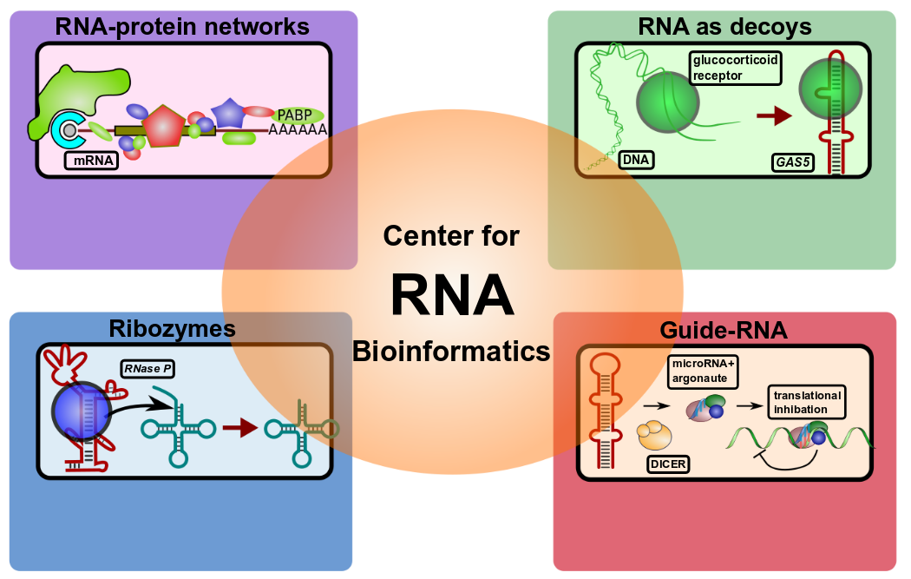

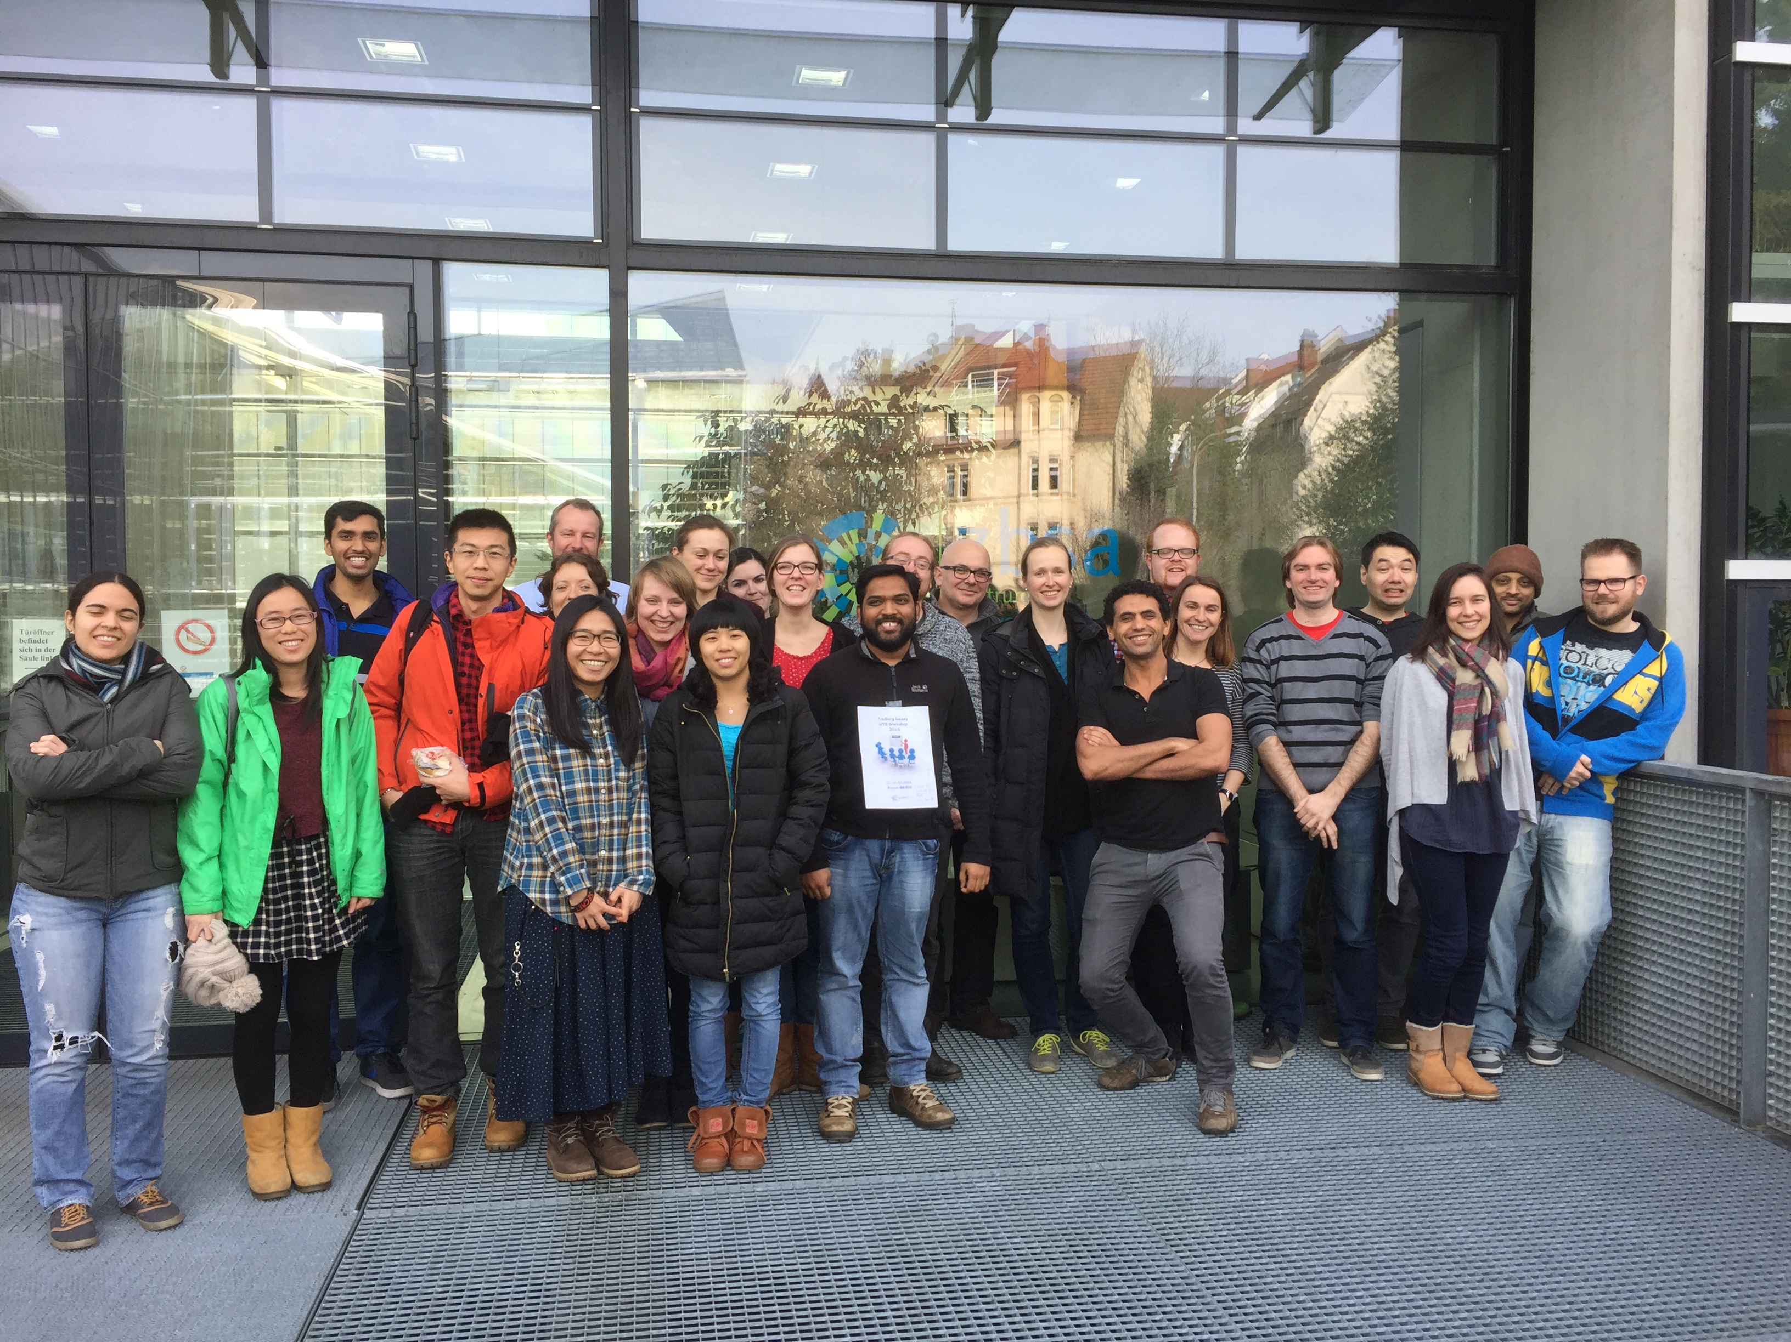
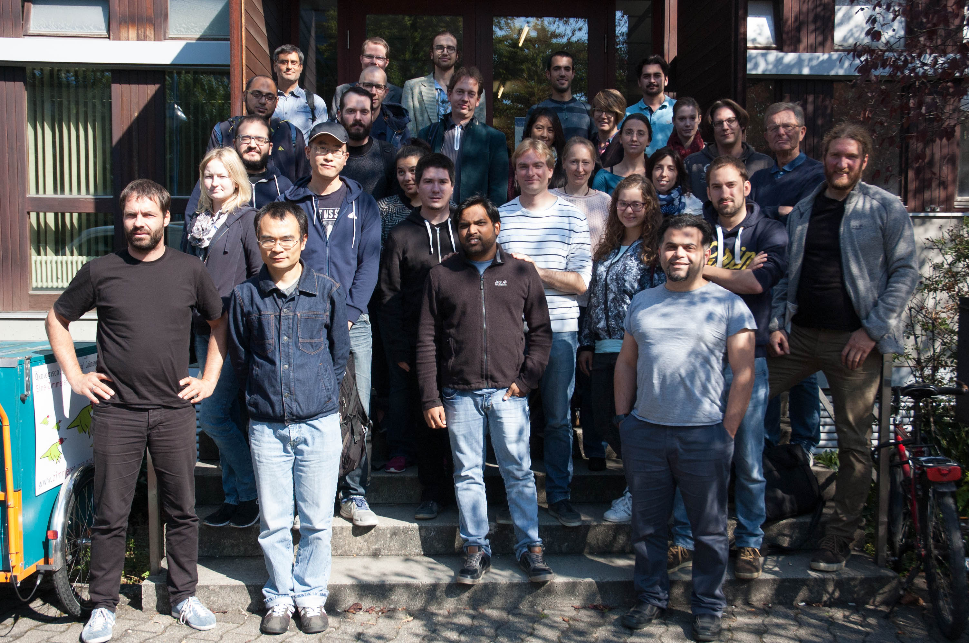



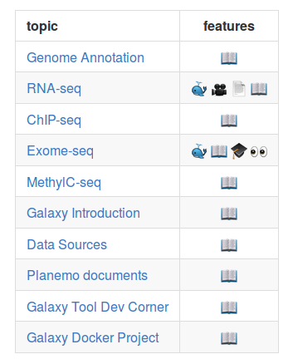




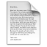





de.NBI − German Network for Bioinformatics Infrastructure
RBC
RNA Bioinformatics Center
University of Freiburg
Chair of Prof. Rolf Backofen
Rolf Backofen, Bérénice Batut, Anika Erxleben, Torsten Houwaart
RNA Bioinformatics Center, University of Freiburg, Germany
Short description of the project
Progress report
The RBC Freiburg offers tools, services and training for the analysis of high-throughput sequencing (HTS) data, RNA-RNA interactions, and RNA-protein interactions.
Organisation of 6 training courses aimed at teaching users common HTS techniques, tool development, and Galaxy implementation
Organisation of contribution fests aimed at making software more readily available
Ongoing evaluation of new analysis techniques, methods and software for RNA-RNA and RNA-protein interactions
Successful migration of all our training material and documentation of standard analysis workflows to online repositories for easier collaboration
Ongoing curation and development of training material to include newer versions of tools, and to cover emerging new techniques requested by users
Development and maintenance of standard analysis pipelines and definition of SOPs
Active participation in the BioStars forum to offer answers to frequently asked user-questions
Close cooperation and knowledge exchange with ELIXIR
- analysis of CLIPseq data
- detection of RNA motifs
- RNA-protein interactions
- RNA structure prediction
- detection of ncRNAs
- RNA structure prediction
- RNA conserveration
- ncRNA target prediction
- miRNA/ncRNA detection
Furthermore, the RBC Freiburg develops and maintains the Freiburg Galaxy server, which is the largest instance in Europe.
de.NBI services
de.NBI training and education
The Freiburg Galaxy server⁽¹⁾ enables scientists for accessible, reproducible and transparent research of biomedical data. As part of the de.NBI Cloud, the Freiburg Galaxy server will be available for all German research facilities in the beginning of 2017.
The RBC Freiburg offers biannual 1-week full-day hands-on Galaxy training courses on HTS data analysis. Only for that workshop, we teached >220 participants in the last 3 years. Beside HTS data analysis workshops, in 2016 we offered workshops for Galaxy developers in cooperation with ELIXIR.
06th – 07th Apr 2016 Galaxy DevOps workshop, Heidelberg
20th- 21st Oct 2016 Swiss German Galaxy workshop, Freiburg
27th Oct 2016 de.NBI data management workshop, Kassel
Upcoming events
15th - 16th Dec 2016, RNA-seq data analysis workshop, Freiburg
13th - 17th Feb 2017 Galaxy HTS data analysis workshop, Freiburg
Hands-on training material for self-study available
To overcome limited capacities in our workshops, we developed free accessible training material for self-learning.
The RBC Freiburg is actively involved in making software user-accessible. Tools relevant for HTS data analysis, RNA-protein interaction analysis (e.g. CLIP experiments), RNA-RNA interaction analysis are made available through distribution channels such as Conda⁽²⁾.
The main aim is the development of the RNA workbench⁽³⁾, a server for a series of RNA research tools. Among 55 RNA analysis tools, there are applications for e.g. for sequence-structure alignments (LocARNA, CARNA, MARNA), clustering (ExpaRNA), interaction prediction (IntaRNA, CopraRNA), homolog identification (GLASSgo), sequence design (AntaRNA, INFORNA, SECISDesign), CRISPR repeat analyses (CRISPRmap), and many more tasks.
Freiburg Galaxy HTS data analysis workshops February (left) and September 2016 (right)
Analysis frameworks for specific tasks are made available as Docker images⁽⁴⁾ which incorporate a Galaxy web server with seamlessly included tools, SOP analysis pipelines, training material, a Galaxy interactive tour, and help pages.
(1) http://galaxy.uni-freiburg.de (3) http://rna.informatik.uni-freiburg.de/ & /r/bgruening/galaxy-rna-workbench/
(2) https://bioconda.github.io/ (4) https://hub.docker.com
https://github.com
/bgruening/training-material
Publications
docker image available
video available
Interactive tour available
Galaxy page available
annotated text available
introductory slides available
“Tools and data services registry: a community effort to document bioinformatics resources.”
doi: 10.1093/nar/gkv1116
“The Galaxy platform for accessible, reproducible and collaborative biomedical analyses: 2016 update.” doi: 10.1093/nar/gkw343
“Enhancing pre-defined workflows with ad hoc analytics using Galaxy, Docker and Jupyter.”
doi: 10.1101/075457
“Global RNA recognition patterns of post-transcriptional regulators Hfq and CsrA revealed by UV crosslinking in vivo.” doi: 10.15252/embj.201593360
“RC3H1 post-transcriptionally regulates A20 mRNA and modulates the activity of the IKK/NF-kappaB pathway” doi:10.1038/ncomms8367
Förderkennzeichen Nr…..
http://www.denbi.de

